Slide 1
Business Analytics Project
Week 4
15146302 Kang, Euiheyon
15146304 Ku, Seunghyo
15146312 Park, Gangmin

Slide 2

CONTENTS
Cross Validation
Modeling

Slide 3
1. Cross Validation

Slide 4
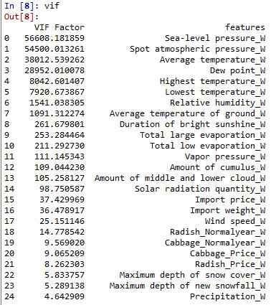


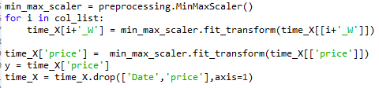
1. Cross validation
- moving_average
- VIF
Predict After 1 week with 7days average
- min_max

Slide 5
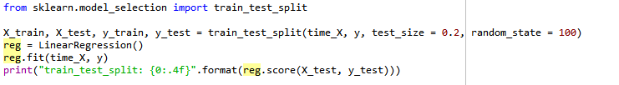
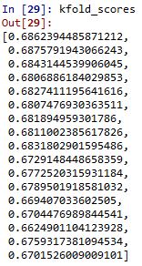
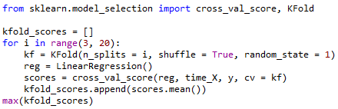
1. Cross validation
- Using train_test_split(): 0.6750 (Linear Regression)
- Using K-Fold Algorithm: 0.687 when k is 4 (Linear Regression)
K = 3~20, shuffle = True, random_state = 1

Slide 6
2. Modeling

Slide 7
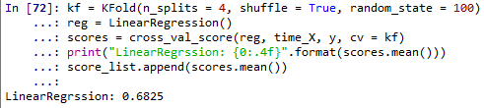
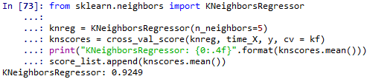
2. Modeling
- Linear Regression : 0.6825
K = 4, shuffle = True, random_state = 100
- KNeighborsRegression : 0.9249
K = 4, shuffle = True, random_state = 100, neighbor=5

Slide 8
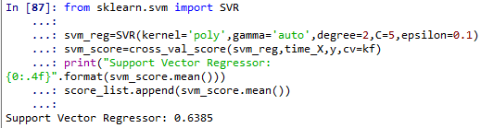
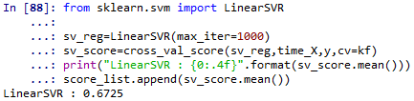
2. Modeling
- Support Vector Regression : 0.6385
K = 4, shuffle = True, random_state = 100 , degree=2, c=5, epsilon=0.1)
- Linear Support Vector regression : 0.6725
K = 4, shuffle = True, random_state = 100, max_iter =1000

Slide 9


2. Modeling
- Random Forest Regression : 0.8139
K = 4, shuffle = True, random_state = 100, max_depth =5
- Light GBM Regression: 0.8912
K = 4, shuffle = True, random_state = 100,

Slide 10
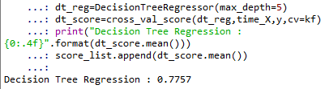

2. Modeling
- Decision Tree Regression : 0.7757
K = 4, shuffle = True, random_state = 100,
- Gradient Boosting Regression: 0.8610
K = 4, shuffle = True, random_state = 100,

Slide 11
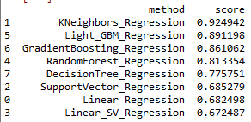
2. Modeling
Top - 5 Model
Kneighbors_Regression
Light Gradient Boosting Machine Regression
Gradient Boosting Machine Regression
Random Forest Regression
DecisionTree
92.4 %
89.1 %
86.1 %
81.3 %
77.5 %

